Slide 1
The Upside Down:
Recording Computational Research
Ben Heil
@autobencoder

Slide 2
Different tools, similar ideas
Image cred: Stranger Things wiki
Notes:
Why you should care about comp bio even if you’re in wet lab
Goal: not to teach people how to do things but to point them in the right direction

Slide 3
Version Control
Version control = lab notebook

Slide 4
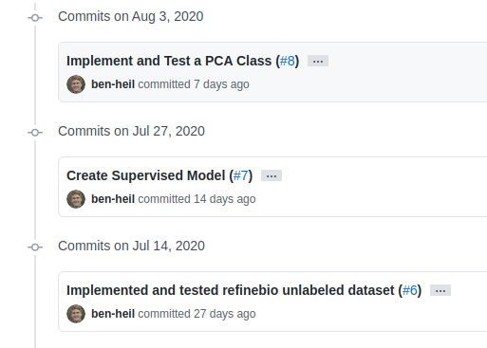
Version Control
Version control = lab notebook

Slide 5
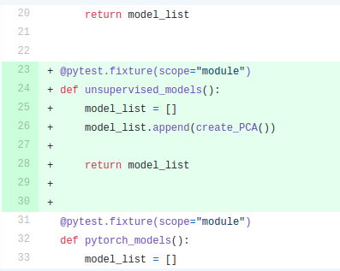
Version Control
Version control = lab notebook

Slide 6
Version Control Tools
Git: The version control software that tracks your changes
Github: The website that stores your code for you

Slide 7
Making Code Available
Notes:
Code can be published before a paper, or be public the whole time you write it

Slide 8
Making Code Available
Publishing code

Slide 9
Eliminating Manual Steps
Notes:
In computational research you tend to build your own thermocyclers

Slide 10
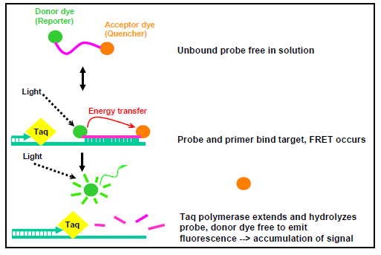
Eliminating Manual Steps
https://www.cdc.gov/meningitis/lab-manual/chpt10-pcr.html
Notes:
In computational research you tend to build your own thermocyclers

Slide 11
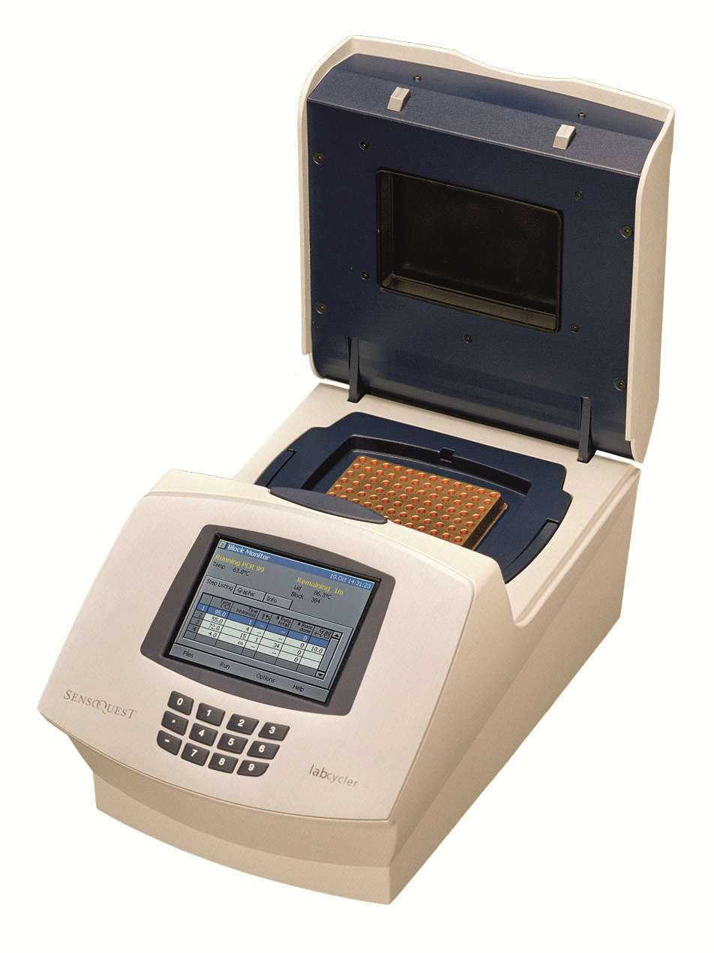
Eliminating Manual Steps
https://www.cdc.gov/meningitis/lab-manual/chpt10-pcr.html
https://www.sensoquest.de/
Notes:
In computational research you tend to build your own thermocyclers

Slide 12
Eliminating Manual Steps
Single purpose scripts
Entire Projects

Slide 13
Packages
Notes:
They’re like QIAGen kits - you could mix all your reagents yourself, or you can use someone else’s work to make your life easier

Slide 14
Package Management
Recording your reagents

Slide 15
Package Management Options
Python

Slide 16
Package Management Options
Python
R

Slide 17
Package Management Options
Python
R

Slide 18
Questions?

